Slide 1
Basic Matching Model
INFO 4220 – Networks II: Market Design
Based on Haeringer Ch.9

Slide 2
Today
We will introduce 1 to 1 matching problems
What defines a good match and how do we find it
  Stability
  Gale-Shapley deferred acceptance algorithm
In the next few lectures we will study different settings that had some sort of market failure that was solved by using market design. For example:
  National Residence Matching Program
  The school Choice problem
  Kidney exchanges
  Dorm and course assignments

Slide 3
Matching Markets
Gale & Shapley (1962) publish influential contribution in game theory that marks the start of market design
Recently, market design has been increasingly employed in different settings with good outcomes
In 2012 Shapley and Roth received the Nobel Memorial Prize in Economics Science for “the theory of stable allocations and the practice of market design” (David Gale died in 2008)
According to A. Roth, this is one of the settings where economists “understand enough about how markets work so that we can help in that process”

Slide 4
The Basic Matching Model
This model is based in Gale & Shapley’s model from 1962
There are two sets of agents: Musicians and Singers
The problem is that we want to match musicians to singers according to their preferences
Each individual can be matched to at most one person
A musician (or a singer) can be either be matched or unmatched to a singer (or a musician)

Slide 5
The Basic Matching Model
This is what is known as a two-sided, one-to-one model
  Two-sided: We are matching one side of the market (musicians) to other side of the market (singers)
  One-to-one: Each agent can be matched to only one other agent
There are other models:
  Many-to-one matching (matching students to colleges)
  Many-to-many matching (students and professors)

Slide 6
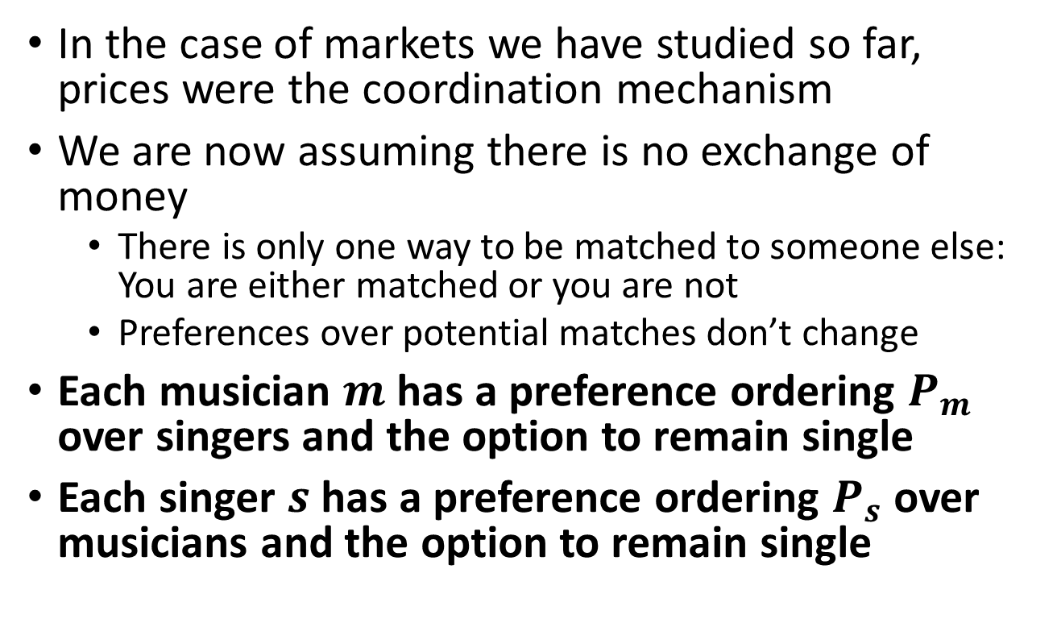
Preferences
In the case of markets we have studied so far, prices were the coordination mechanism
We are now assuming there is no exchange of money
  There is only one way to be matched to someone else: You are either matched or you are not
  Preferences over potential matches don’t change
Each musician $m$ has a preference ordering $P_{m}$ over singers and the option to remain single
Each singer $s$ has a preference ordering $P_{s}$ over musicians and the option to remain single

Slide 7
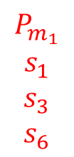
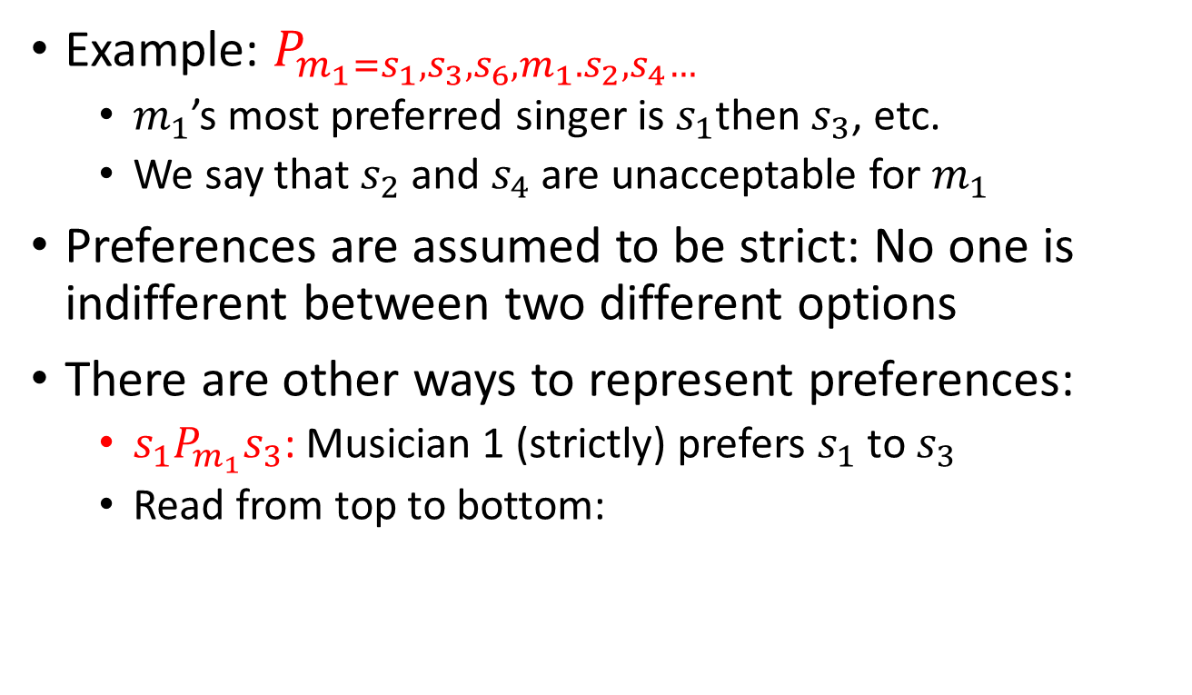
Preferences
Example: $P_{m_{1}=s_{1},s_{3},s_{6},m_{1}. s_{2},s_{4}…}$
  $m_{1}$’s most preferred singer is $s_{1}$then $s_{3}$, etc.
  We say that $s_{2}$ and $s_{4}$ are unacceptable for $m_{1}$
Preferences are assumed to be strict: No one is indifferent between two different options
There are other ways to represent preferences:
  $s_{1}P_{m_{1}}s_{3}$: Musician 1 (strictly) prefers $s_{1}$ to $s_{3}$
  Read from top to bottom:
$$P_{m_{1}}$$
$$s_{1}$$
$$s_{3}$$
$$s_{6}$$

Slide 8
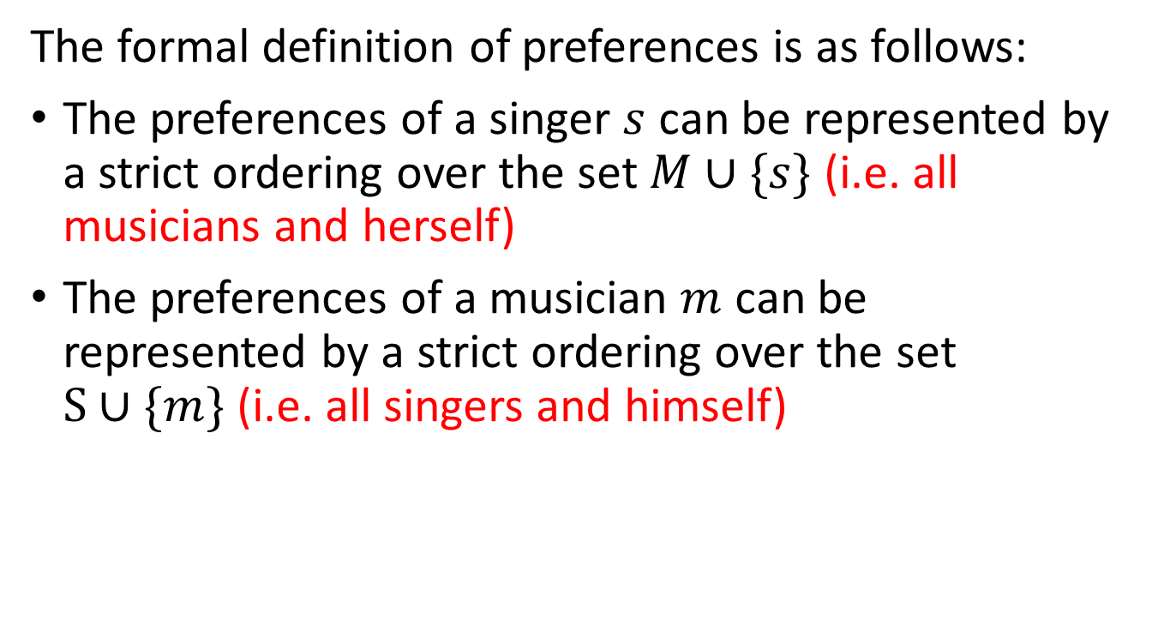
Preferences
The formal definition of preferences is as follows:
The preferences of a singer $s$ can be represented by a strict ordering over the set $M∪\{s\}$ (i.e. all musicians and herself)
The preferences of a musician $m$ can be represented by a strict ordering over the set $S∪\{m\}$ (i.e. all singers and himself)

Slide 9
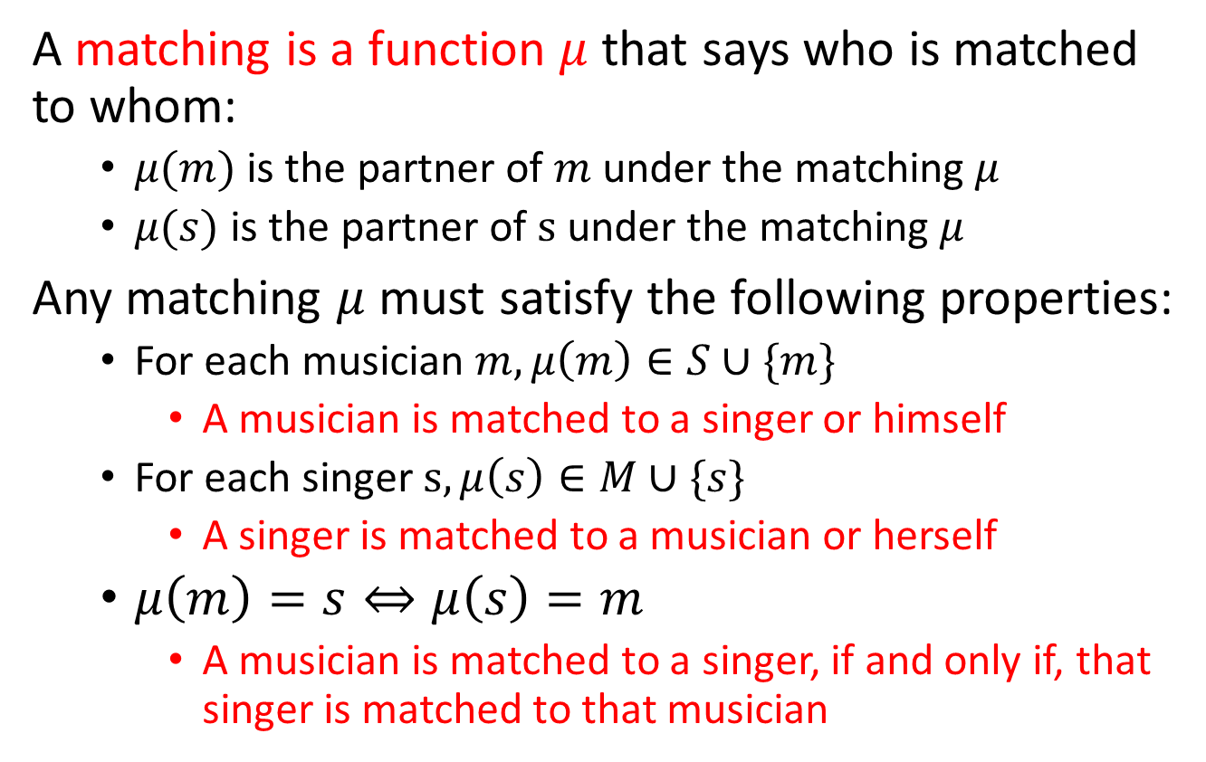
Matching
A matching is a function $μ$ that says who is matched to whom:
  $μ(m)$ is the partner of $m$ under the matching $μ$
  $μ(s)$ is the partner of $s$ under the matching $μ$
Any matching $μ$ must satisfy the following properties:
  For each musician $m, μ\left(m\right)∈S∪\{m\}$
    A musician is matched to a singer or himself
  For each singer $s, μ\left(s\right)∈M∪\{s\}$
    A singer is matched to a musician or herself
  $μ\left(m\right)=s⇔μ\left(s\right)=m$
    A musician is matched to a singer, if and only if, that singer is matched to that musician

Slide 10
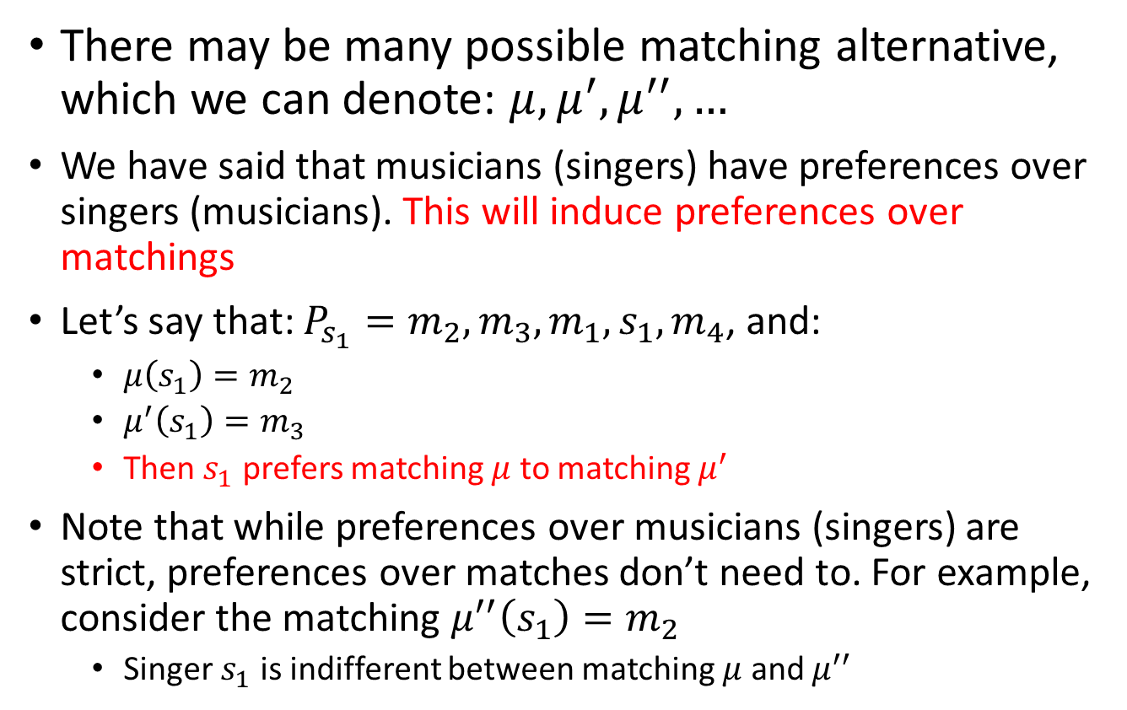
Matching
There may be many possible matching alternative, which we can denote: $μ, μ^{′}, μ^{′′}, …$
We have said that musicians (singers) have preferences over singers (musicians). This will induce preferences over matchings
Let’s say that: $P_{s_{1}}=m_{2},m_{3},m_{1},s_{1},m_{4}$, and:
  $μ\left(s_{1}\right)=m_{2}$
  $μ^{′}\left(s_{1}\right)=m_{3}$
  Then $s_{1}$ prefers matching $μ$ to matching $μ^{′}$
Note that while preferences over musicians (singers) are strict, preferences over matches don’t need to. For example, consider the matching $μ^{′′}\left(s_{1}\right)=m_{2}$
  Singer $s_{1}$ is indifferent between matching $μ$ and $μ^{′′}$

Slide 11
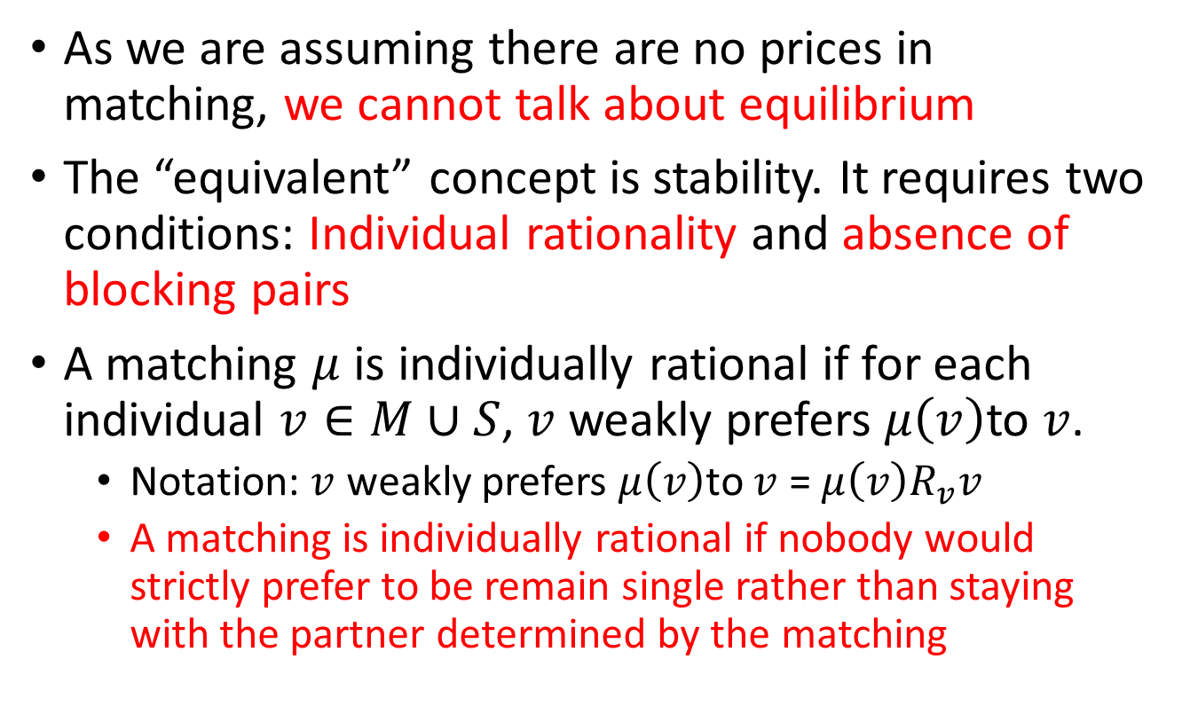
Stability
As we are assuming there are no prices in matching, we cannot talk about equilibrium
The “equivalent” concept is stability. It requires two conditions: Individual rationality and absence of blocking pairs
A matching $μ$ is individually rational if for each individual $v∈M∪S$, $v$ weakly prefers $μ\left(v\right)$to $v$.
  Notation: $v$ weakly prefers $μ\left(v\right)$to $v$ = $μ\left(v\right)R_{v}v$
  A matching is individually rational if nobody would strictly prefer to be remain single rather than staying with the partner determined by the matching

Slide 12
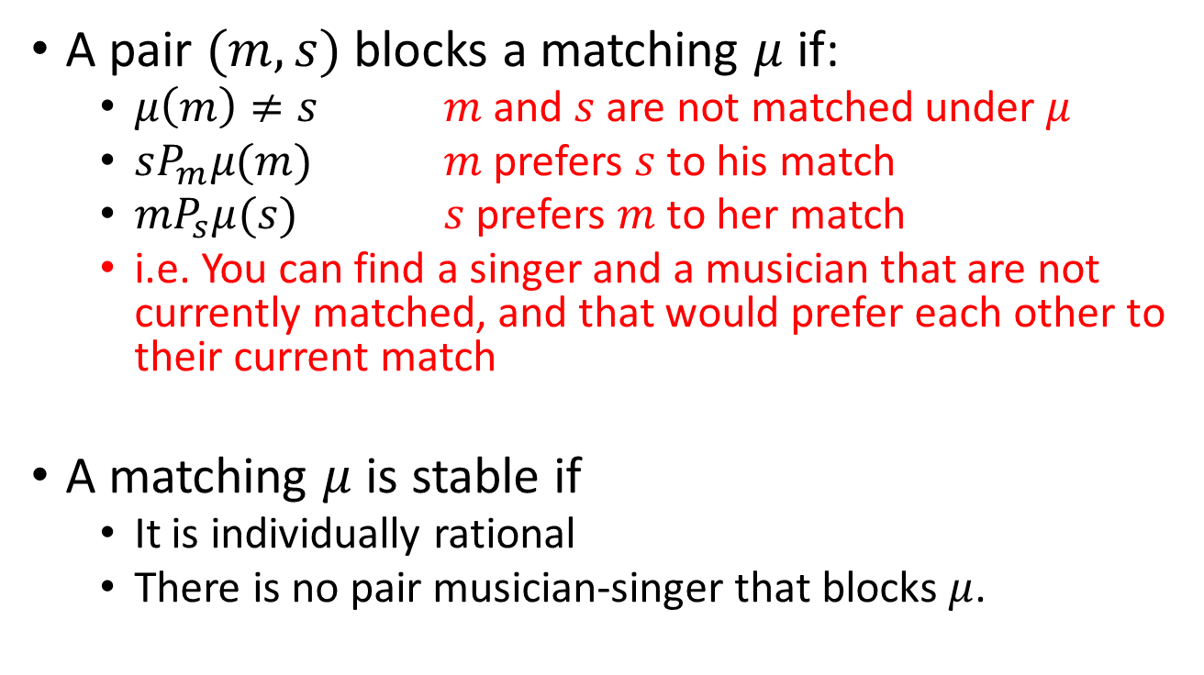
Stability
A pair $(m,s)$ blocks a matching $μ$ if:
  $μ\left(m\right)≠s$ $m$ and $s$ are not matched under $μ$
  $sP_{m}μ(m)$ $m$ prefers $s$ to his match
  $mP_{s}μ(s)$ $s$ prefers $m$ to her match
  i.e. You can find a singer and a musician that are not currently matched, and that would prefer each other to their current match
A matching $μ$ is stable if
  It is individually rational
  There is no pair musician-singer that blocks $μ$.

Slide 13
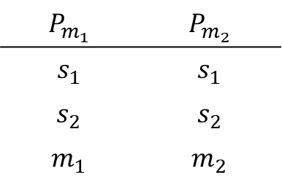
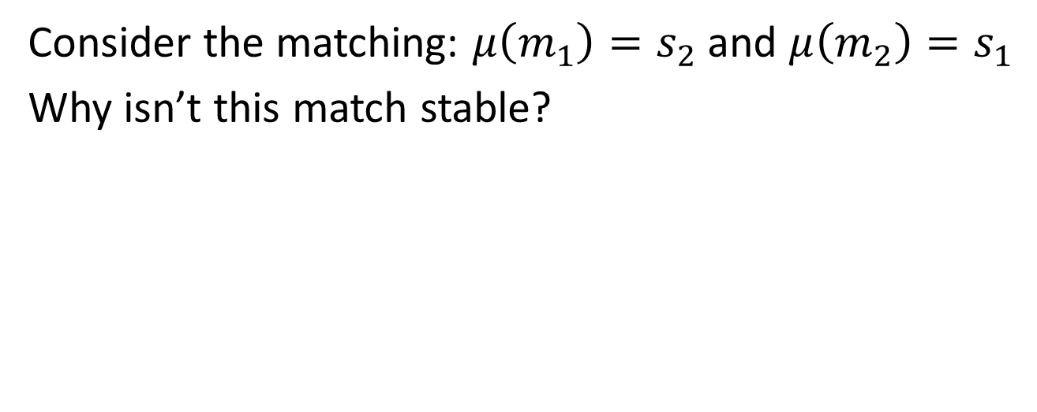
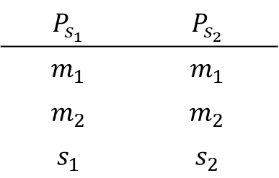
Example
$$P_{m_{1}}$$ | $$P_{m_{2}}$$
$$s_{1}$$ | $$s_{1}$$
$$s_{2}$$ | $$s_{2}$$
$$m_{1}$$ | $$m_{2}$$
$$P_{s_{1}}$$ | $$P_{s_{2}}$$
$$m_{1}$$ | $$m_{1}$$
$$m_{2}$$ | $$m_{2}$$
$$s_{1}$$ | $$s_{2}$$
Consider the matching: $μ\left(m_{1}\right)=s_{2}$ and $μ\left(m_{2}\right)=s_{1}$
Why isn’t this match stable?

Slide 14
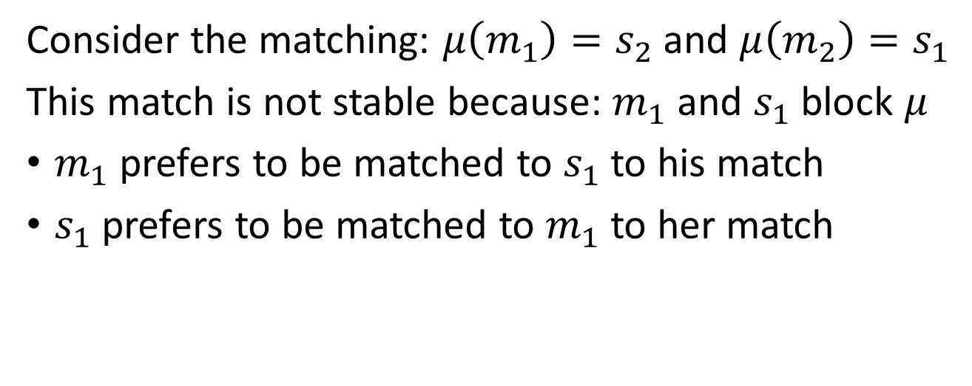
Example
$$P_{m_{1}}$$ | $$P_{m_{2}}$$
$$s_{1}$$ | $$s_{1}$$
$$s_{2}$$ | $$s_{2}$$
$$m_{1}$$ | $$m_{2}$$
$$P_{s_{1}}$$ | $$P_{s_{2}}$$
$$m_{1}$$ | $$m_{1}$$
$$m_{2}$$ | $$m_{2}$$
$$s_{1}$$ | $$s_{2}$$
Consider the matching: $μ\left(m_{1}\right)=s_{2}$ and $μ\left(m_{2}\right)=s_{1}$
This match is not stable because: $m_{1}$ and $s_{1}$ block $μ$
$m_{1}$ prefers to be matched to $s_{1}$ to his match
$s_{1}$ prefers to be matched to $m_{1}$ to her match

Slide 15
Theorem
David Gale & Lloyd Shapley, 1962:
For any preferences, there always exist at least one stable matching
Ok, but how do we find stable matchings?

Slide 16
Deferred Acceptance Algorithm
Musicians make offers to singers in the same order as in their preferences
  Each musician start making offers to his favorite singer
  If rejected, then the musician makes an offer to his second favorite singer
  If rejected, then then musician makes an offer to his third favorite singer …
Each singer always keeps the best musician’s offer (according to her preferences) among the musicians making offers to her (if any), and rejects all others
Algorithm stops when there is no more rejection

Slide 17
Deferred Acceptance with Musicians Proposing
Step 1
Each musician makes an offer to his most preferred acceptable* singer
* If a musician finds all singers unacceptable, he remains single
Each singer who received at least one offer:
Temporarily holds the offer from the most preferred musician among those who made an offer to her and are acceptable
Rejects the other offers

Slide 18
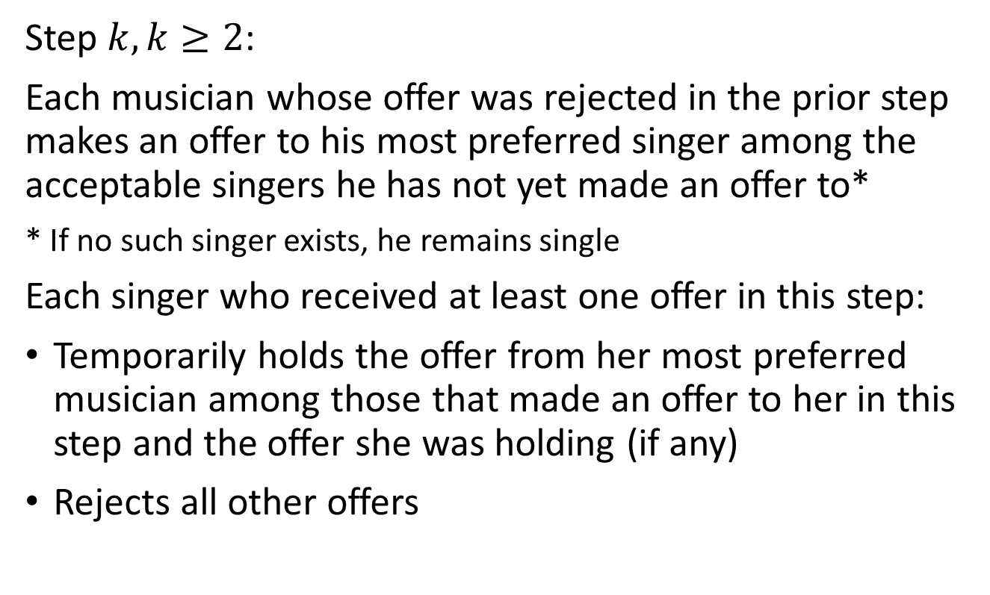
Deferred Acceptance with Musicians Proposing
Step $k,k≥2$:
Each musician whose offer was rejected in the prior step makes an offer to his most preferred singer among the acceptable singers he has not yet made an offer to*
* If no such singer exists, he remains single
Each singer who received at least one offer in this step:
Temporarily holds the offer from her most preferred musician among those that made an offer to her in this step and the offer she was holding (if any)
Rejects all other offers

Slide 19
Deferred Acceptance with Musicians Proposing
END: Algorithm stops when no musician has an offer that is rejected
Final matching:
Each singer is matched to the musician whose offer she was holding when the algorithm stopped (if any)
Each musician is matched to the singer he was temporarily matched when the algorithm stopped (if any)
That is why it is called deferred acceptance

Slide 20
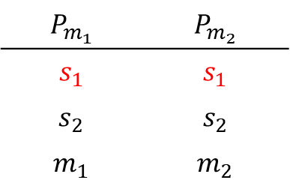
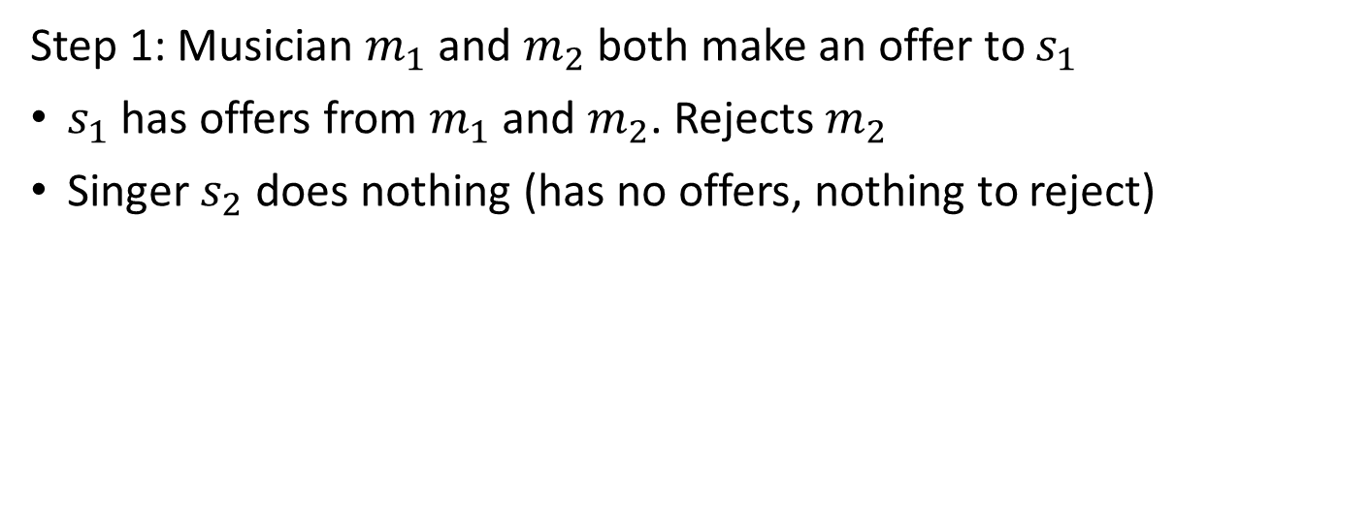
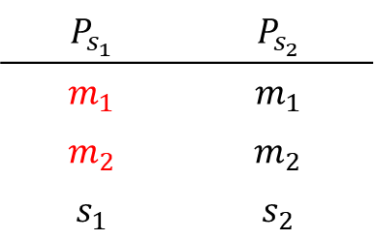
Example
$$P_{m_{1}}$$ | $$P_{m_{2}}$$
$$s_{1}$$ | $$s_{1}$$
$$s_{2}$$ | $$s_{2}$$
$$m_{1}$$ | $$m_{2}$$
$$P_{s_{1}}$$ | $$P_{s_{2}}$$
$$m_{1}$$ | $$m_{1}$$
$$m_{2}$$ | $$m_{2}$$
$$s_{1}$$ | $$s_{2}$$
Step 1: Musician $m_{1}$ and $m_{2}$ both make an offer to $s_{1}$
$s_{1}$ has offers from $m_{1}$ and $m_{2}$. Rejects $m_{2}$
Singer $s_{2}$ does nothing (has no offers, nothing to reject)

Slide 21
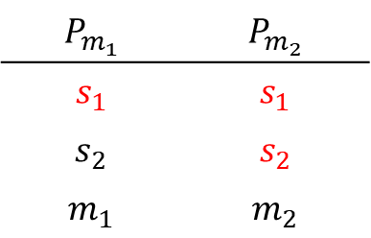
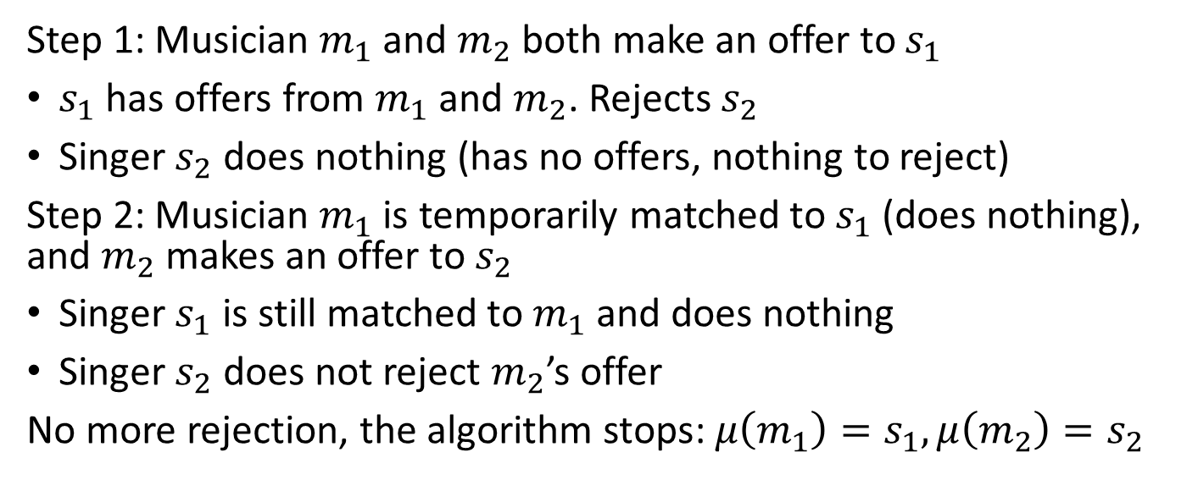
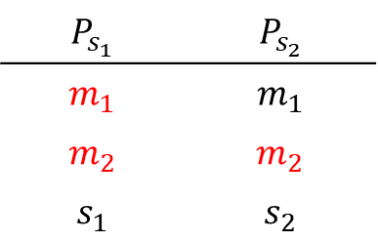
Example
$$P_{m_{1}}$$ | $$P_{m_{2}}$$
$$s_{1}$$ | $$s_{1}$$
$$s_{2}$$ | $$s_{2}$$
$$m_{1}$$ | $$m_{2}$$
$$P_{s_{1}}$$ | $$P_{s_{2}}$$
$$m_{1}$$ | $$m_{1}$$
$$m_{2}$$ | $$m_{2}$$
$$s_{1}$$ | $$s_{2}$$
Step 1: Musician $m_{1}$ and $m_{2}$ both make an offer to $s_{1}$
$s_{1}$ has offers from $m_{1}$ and $m_{2}$. Rejects $s_{2}$
Singer $s_{2}$ does nothing (has no offers, nothing to reject)
Step 2: Musician $m_{1}$ is temporarily matched to $s_{1}$ (does nothing), and $m_{2}$ makes an offer to $s_{2}$
Singer $s_{1}$ is still matched to $m_{1}$ and does nothing
Singer $s_{2}$ does not reject $m_{2}$’s offer
No more rejection, the algorithm stops: $μ\left(m_{1}\right)=s_{1},μ\left(m_{2}\right)=s_{2}$

Slide 22
Which side makes offers?
In the deferred acceptance algorithm, it is important that:
One side makes the offers, the other side accepts/rejects the offers
No obligation to have musician proposing, it could be singers proposing
(who proposes does matter for the outcome that is reached)

Slide 23
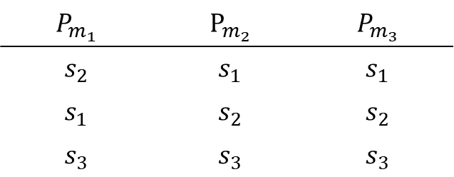
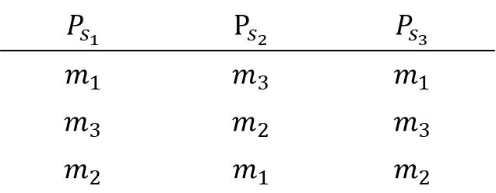
Example
$$P_{m_{1}}$$ | $$P_{m_{2}}$$ | $$P_{m_{3}}$$
$$s_{2}$$ | $$s_{1}$$ | $$s_{1}$$
$$s_{1}$$ | $$s_{2}$$ | $$s_{2}$$
$$s_{3}$$ | $$s_{3}$$ | $$s_{3}$$
$$P_{s_{1}}$$ | $$P_{s_{2}}$$ | $$P_{s_{3}}$$
$$m_{1}$$ | $$m_{3}$$ | $$m_{1}$$
$$m_{3}$$ | $$m_{2}$$ | $$m_{3}$$
$$m_{2}$$ | $$m_{1}$$ | $$m_{2}$$
Find the matching that would result from the DA algorithm with musicians proposing:

Slide 24
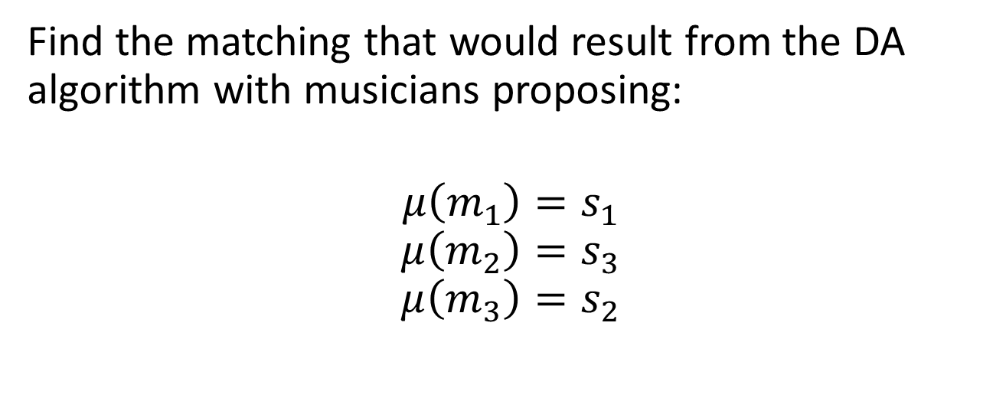
Example
$$P_{m_{1}}$$ | $$P_{m_{2}}$$ | $$P_{m_{3}}$$
$$s_{2}$$ | $$s_{1}$$ | $$s_{1}$$
$$s_{1}$$ | $$s_{2}$$ | $$s_{2}$$
$$s_{3}$$ | $$s_{3}$$ | $$s_{3}$$
$$P_{s_{1}}$$ | $$P_{s_{2}}$$ | $$P_{s_{3}}$$
$$m_{1}$$ | $$m_{3}$$ | $$m_{1}$$
$$m_{3}$$ | $$m_{2}$$ | $$m_{3}$$
$$m_{2}$$ | $$m_{1}$$ | $$m_{2}$$
Find the matching that would result from the DA algorithm with musicians proposing:
$$μ\left(m_{1}\right)=s_{1}$$
$$μ\left(m_{2}\right)=s_{3}$$
$$μ\left(m_{3}\right)=s_{2}$$

Slide 25
Example
$$P_{m_{1}}$$ | $$P_{m_{2}}$$ | $$P_{m_{3}}$$
$$s_{2}$$ | $$s_{1}$$ | $$s_{1}$$
$$s_{1}$$ | $$s_{2}$$ | $$s_{2}$$
$$s_{3}$$ | $$s_{3}$$ | $$s_{3}$$
$$P_{s_{1}}$$ | $$P_{s_{2}}$$ | $$P_{s_{3}}$$
$$m_{1}$$ | $$m_{3}$$ | $$m_{1}$$
$$m_{3}$$ | $$m_{2}$$ | $$m_{3}$$
$$m_{2}$$ | $$m_{1}$$ | $$m_{2}$$
Find the matching that would result from the DA algorithm with singers proposing

Slide 26
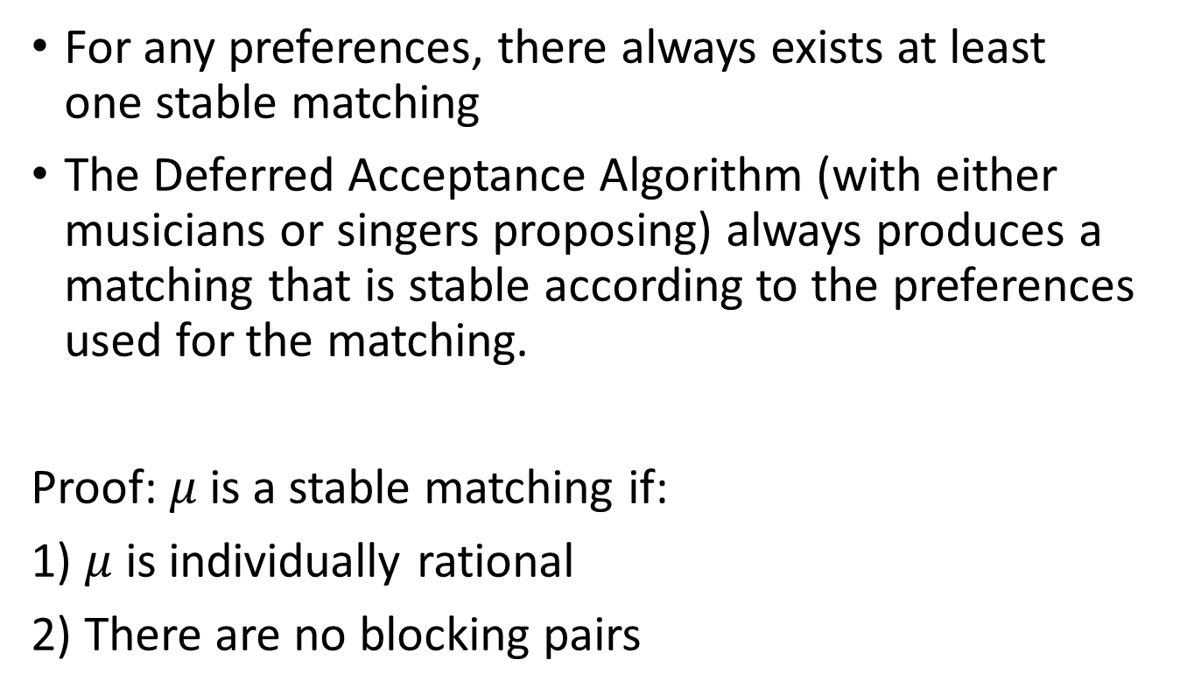
Gale and Shapley’s Theorem
For any preferences, there always exists at least one stable matching
The Deferred Acceptance Algorithm (with either musicians or singers proposing) always produces a matching that is stable according to the preferences used for the matching.
Proof:$μ$ is a stable matching if:
1) $μ$ is individually rational
2) There are no blocking pairs

Slide 27
Gale and Shapley’s Theorem
The outcome of the deferred acceptance algorithm is necessarily individually rational:
No musician makes an offer to a singer that he considers unacceptable
No singer accepts an offer from a musician that she considers unacceptable
Now let’s see if there are blocking pairs

Slide 28
Gale and Shapley’s Theorem
Let’s say that Bob is matched to Beth and Alice to Adam.
Let’s assume (Bob, Alice) is a blocking pair:
1) Alice prefers Bob to Adam (her match in the D.A.)
2) Bob prefer Alice to Beth (his match in the D.A.)
  As Bob was making the offers and he prefers Alice to Beth, he must have made an offer to Alice BEFORE making an offer to Beth
  If Bob made offers AFTER proposing to Alice (eventually to Beth) then he must have been rejected by Alice
This is a contradiction because:
If Alice accepted the offer from Adam, she must like Adam better than Bob

Slide 29
Which Stable Matching
We have said that for all preferences there is going to be at least one stable matching
There could be many stable matchings too
How do we choose one of the possible stable matchings?
Who is going to prefer which matching?

Slide 30
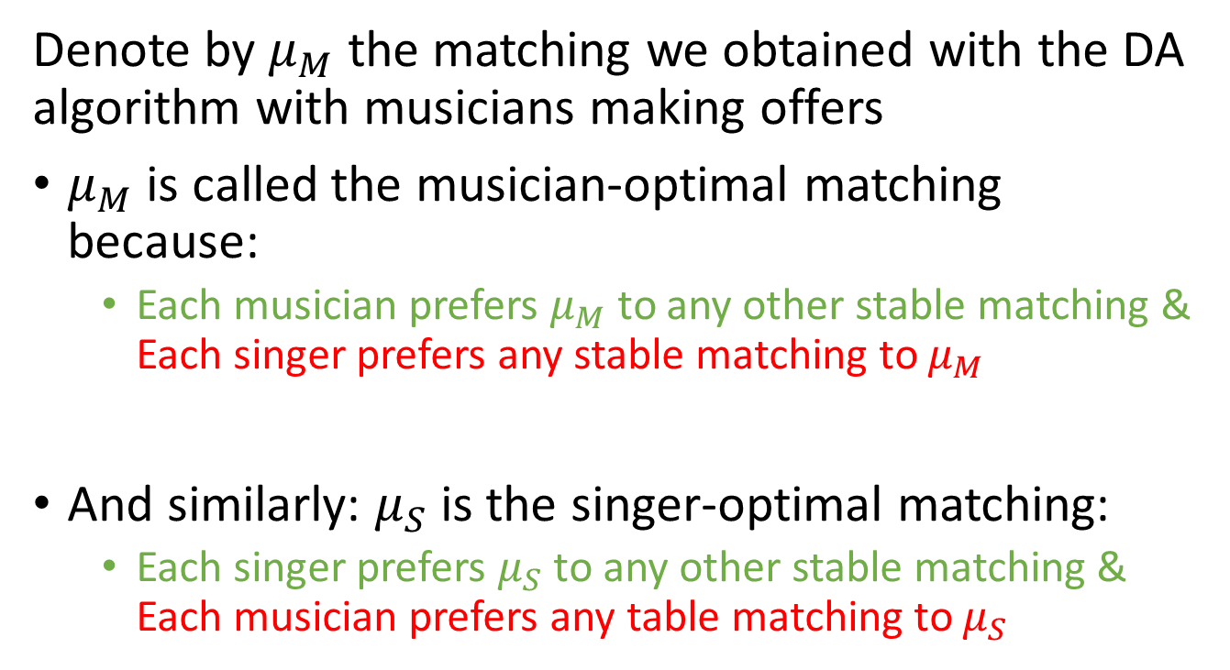
Optimality
Denote by $μ_{M}$ the matching we obtained with the DA algorithm with musicians making offers
$μ_{M}$ is called the musician-optimal matching because:
  Each musician prefers $μ_{M}$ to any other stable matching & Each singer prefers any stable matching to $μ_{M}$
And similarly: $μ_{S}$ is the singer-optimal matching:
  Each singer prefers $μ_{S}$ to any other stable matching & Each musician prefers any table matching to $μ_{S}$

Slide 31
Incentives in the DA algorithm
We have been assuming that we know the true preferences of musicians and singers
  Could they lie to obtain a better matching?
Consider the following mechanism:
  Musicians and singers (simultaneously) submit their preferences
  The DA algorithm is used to create a matching using the submitted preferences
  The matching is announced
Will musicians and singers reveal their true preferences?

Slide 32
Strategyproofness of DA algorithm
Theorem:
A matching mechanism that uses the Deferred Acceptance algorithm is strategyproof for the proposing side
(strategyproof = it is a dominant strategy to reveal one’s true preferences)

Slide 33
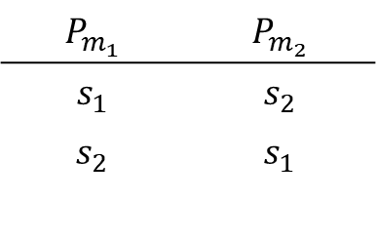
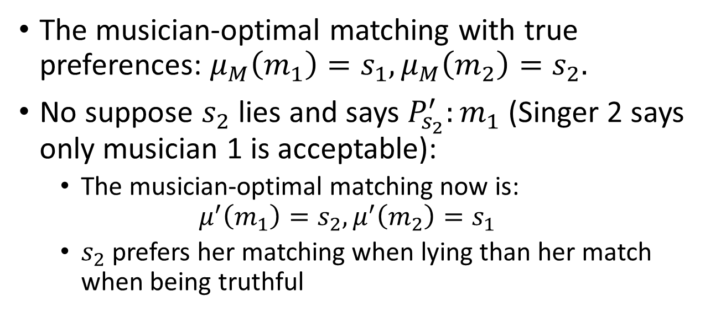
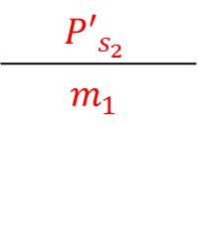
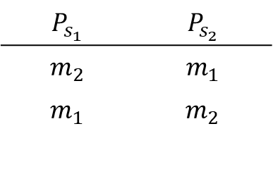
Musicians and singers don’t have the same incentives
$$P_{m_{1}}$$ | $$P_{m_{2}}$$
$$s_{1}$$ | $$s_{2}$$
$$s_{2}$$ | $$s_{1}$$
$$P_{s_{1}}$$ | $$P_{s_{2}}$$
$$m_{2}$$ | $$m_{1}$$
$$m_{1}$$ | $$m_{2}$$
$${P′}_{s_{2}}$$
$$m_{1}$$
The musician-optimal matching with true preferences: $μ_{M}\left(m_{1}\right)=s_{1}, μ_{M}\left(m_{2}\right)=s_{2}.$
No suppose $s_{2}$ lies and says $P_{s_{2}}^{′}:m_{1}$ (Singer 2 says only musician 1 is acceptable):
  The musician-optimal matching now is:
  $$μ^{′}\left(m_{1}\right)=s_{2}, μ^{′}\left(m_{2}\right)=s_{1}$$
  $s_{2}$ prefers her matching when lying than her match when being truthful

Slide 34
Incentives
Deferred Acceptance is not strategyproof for both sides
Is there another algorithm that would do the job?
Theorem:
There is no matching mechanism that satisfies, for any matching problem, the following two properties at the same time:
The matching is stable with respect to the submitted preference list
The mechanism is strategyproof for all individuals

Slide 35
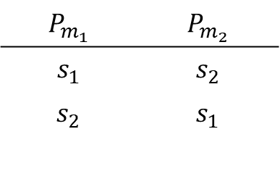
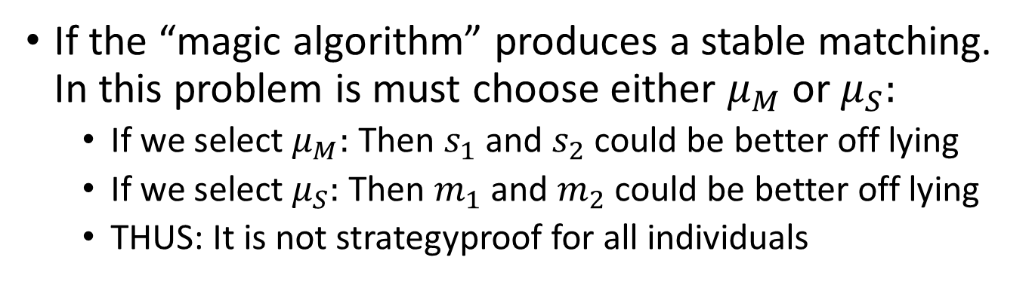
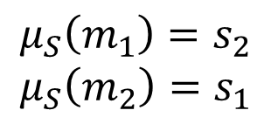
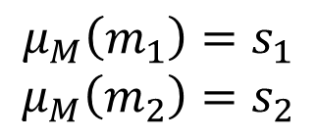
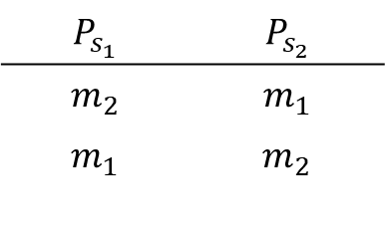
Proof
$$P_{m_{1}}$$ | $$P_{m_{2}}$$
$$s_{1}$$ | $$s_{2}$$
$$s_{2}$$ | $$s_{1}$$
$$P_{s_{1}}$$ | $$P_{s_{2}}$$
$$m_{2}$$ | $$m_{1}$$
$$m_{1}$$ | $$m_{2}$$
Only 2 possible stable matchings:
$$μ_{M}\left(m_{1}\right)=s_{1}$$
$$μ_{M}\left(m_{2}\right)=s_{2}$$
$$μ_{S}\left(m_{1}\right)=s_{2}$$
$$μ_{S}\left(m_{2}\right)=s_{1}$$
If the “magic algorithm” produces a stable matching. In this problem is must choose either $μ_{M}$ or $μ_{S}:$
  If we select $μ_{M}:$ Then $s_{1}$ and $s_{2}$ could be better off lying
  If we select $μ_{S}:$ Then $m_{1}$ and $m_{2}$ could be better off lying
  THUS: It is not strategyproof for all individuals

Slide 36
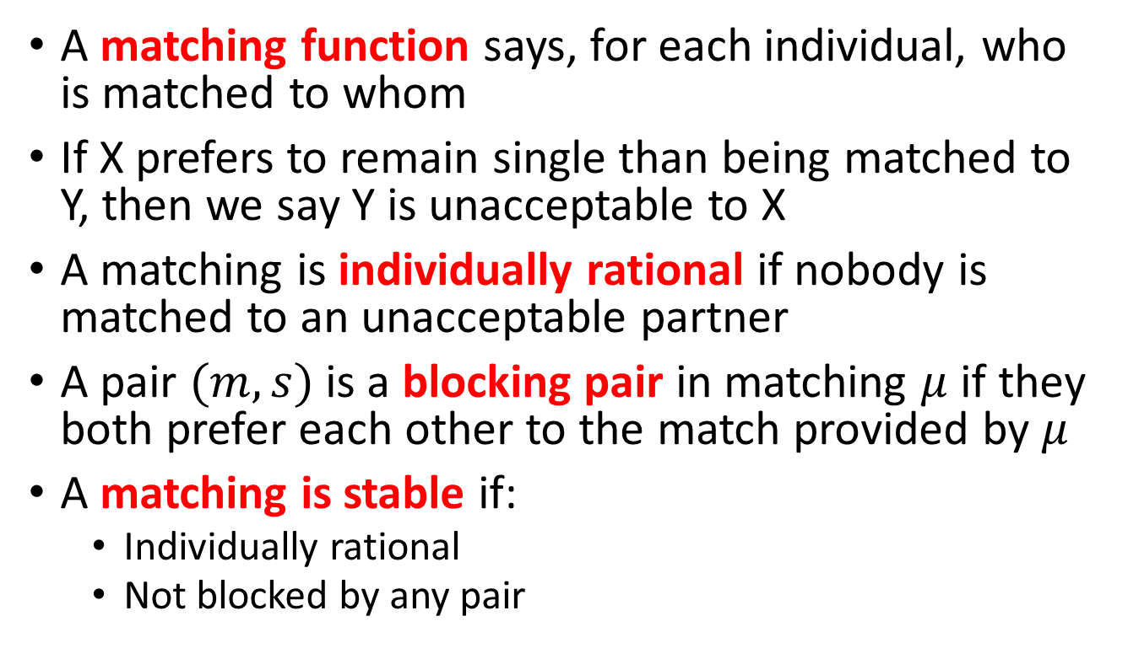
Take away – Matching & Stability
A matching function says, for each individual, who is matched to whom
If X prefers to remain single than being matched to Y, then we say Y is unacceptable to X
A matching is individually rational if nobody is matched to an unacceptable partner
A pair $(m,s)$ is a blocking pair in matching $μ$ if they both prefer each other to the match provided by $μ$
A matching is stable if:
  Individually rational
  Not blocked by any pair

Slide 37
Take away – Deferred Acceptance
The DA algorithm provides a stable matching:
  The most preferred stable matching for the proposing side
  The least preferred stable matching for the receiving side
DA is strategyproof for the proposing side, but not for the receiving side
In general, it is impossible to have strategyproofness for both sides and stability

Slide 38
Take away – Incentives
DA with musicians proposing yield Musician-optimal matching:
  All musicians prefer the musician-optimal matching to any other stable matching
  All singers prefer any other stable matching than the musician-optimal matching
DA with singers proposing: Singer-optimal matching:
  All singers prefer the singer-optimal matching to any other stable matching
  All musicians prefer any other stable matching than the singer-optimal matching

Slide 39
Basic Matching Model
INFO 4220 – Networks II: Market Design
Based on Haeringer Ch.9

